Slide 1
Load Testing your Web Application in Visual Studio:
A Case Study
James Bender
Application Development Practice Lead – ICC
@JamesBender

Slide 2
Today I will not talk about…
What tools are available
How to use things like Visual Studio Test
Detailed instructions on setting up a test lab
How to execute your tests
Anything related to specific test mechanics or code (unless it helps facilitate my points)…

Slide 3
What I do want to talk about…
How I/we approached various load testing engagements
What things worked
What things did not
What things we would do different in the future

Slide 4
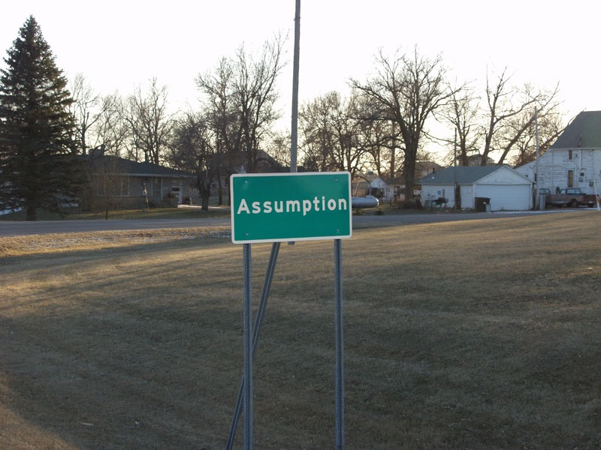
It will be easy…
Notes:
Assumptions
It’s going to be easy
We record the tests and play them back
The results will be clear-cut and easy to understand
The slow points will be made obvious based on the numbers
We don’t need to define slow, everyone knows what slow means
image: https://www.flickr.com/photos/afiler/226337451/in/photolist-m13eR-x5vKxk-6Q157k-rjJbaN-jfiY1D-xnAfJP-e3FVQt-bxMYBi-wyN2pw-xn67B-fuU1Yd-qh5JYC-cduKYd-5NCHo-5zuAG-gNVCFQ-jrUa3C-bhKPxx-6MBtBA-7fBHT9-6Ct7RF-bQfDjB-5Lje3F-6MxvsP-6Pz2LC-4m4Zu8-6MBLnY-6Mxw7F-6MxvWk-6MBFJE-6Mxjag-d43pts-6MBGwu-6Mxvit-6MBFUb-6MBFpQ-6Mxu4r-6MBEhb-6MBDNu-6Mxo1F-6MBxCb-bqVovs-6MBFgu-6MxmGe-6Mx9Zg-6MBy4W-6MxjGr-6Mx5w6-4f88EG-5LjcJZ

Slide 5

Notes:
o Three separate engagements at two clients
• Two were available on Internet, but not for public
• Covered several types of workflows
Membership registration
♣ Pos
♣ Check in and check out
♣ Event registration
♣ Monthly billing
♣ Reports
• Each had similar usages patterns ♣ Had one or ore "surge" periods through day Also had slower periods where reports and back end processes done
• We were brought in at end to load test - One app was already live, looking to scale out
♣ One was a few weeks from production, the other a few days
image: https://www.flickr.com/photos/animationconcept/3177074567/in/photolist-5QKkzH-9jBF7M-r7rJnP-8pTdY6-ihXEAP-avHLUm-n13vCZ-jCgmqT-gkZWny-diLJaA-dgTLfn-dKoizB-cnVQ7L-dF1VCp-bdLnxH-dN9PeL-bvnnee-cAZiV5-uErMT6-dSXsDv-eRwjMr-dPfjfT-dkNrEJ-cEWsLA-d8ahyo-cKcBus-anV7uA-nh7mdY-nJGbvc-4cGXMq-eq1yeG-dWDgdn-cwCpqb-ccTVaY-dCHur5-bEydtu-ceJFpN-dfsRsV-qqqLUY-fWkTUH-uXJ3X7-qfJ22x-q4BpUD-rvooqi-oUmzjL-vgyWV8-f7o62Z-j55EWV-nhZSXj-qEx8da

Slide 6

Key Point #1
Don’t wait till your “done” to do load testing!

Slide 9
The Approach
Technical
Functional

Slide 10
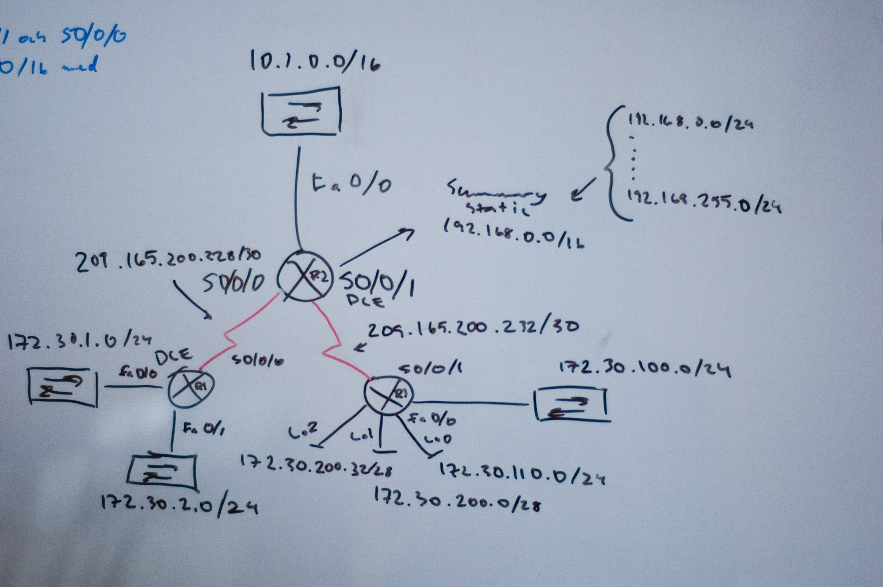
Technical
Were able to use Azure load testing service for one project
Could not use Azure for the project that used VPN
Could not use Azure for the third, hosting company forbade it
Notes:
https://www.flickr.com/photos/lindztrom/3928579678/in/photolist-6Z9ZSo-768uik-6fAEek-87DCm1-4ESsW-7oKsR7-iGKba-6fEQ91-5TZxmf-5TVd92-8ZD5Kc-6fEPhm-6h4M9C-5TVcL4-4p2Hr2-5TZwSy-5TVcZB-5eqj4d-8bCDrw-6fEQj7-8bCCVS-8bCEyf-768u3D-8bCEW3-6fAEng-79QJCN-6fAErR-5TZwWb-6fEQtf-8bCEPY-8bCE3U-6fAEjF-6fEQ6u-6fAEwi-6fAEua-5TZx7u-6fEQs9-6fAEgx-6fEPjS-8bCDcY-8bznP6-8bCDKd-76cocW-76cohm-76cobA-dUypBE-6z4i3M-9XobEd-6HJPHq-7GBb8u

Slide 11
Key Point #2
If your hosting company wont let you load test, find a new hosting company.

Slide 12

Functional Approach
Break down daily activities into small, composable pieces
Use those smaller pieces to compose larger UI tests
Use the UI tests to create load tests
Notes:
https://www.flickr.com/photos/binaryape/4882162452/in/photolist-8rqmNG-nNSkQU-6kckHp-mB124t-5vgq6Y-7r2e3h-8cD5nx-4WHXzW-pd6c6M-kcRd7x-7yahjU-rgf3RD-a4JZq-bH4FWc-8hDCW3-7HSuP2-byFRMV-iDBVd1-qS9iii-jwPswV-rByRS7-x8YA2b-qmoRhB-2sWNXX-nrEDTy-4CHj67-8Cjveb-bC2UPc-GW2Va-ibCEkV-aswFR8-7KtbgT-tReNJt-4r5sPk-4CHiyy-28i54x-7QTwNd-d7HmTA-uj58iZ-brT6Uv-5sARbG-s8otHi-dXkp3b-bB13yf-78SpzZ-i9sMcF-gmv5Vj-4BrcEY-5LfUcS-9QALSm

Slide 13
Functional Approach
Point of
Sale
Point of
Sale
Event
Registration
Event
Registration
Monthly
Billing
Report
Monthly
Billing
Report
Notes:
https://www.flickr.com/photos/binaryape/4882162452/in/photolist-8rqmNG-nNSkQU-6kckHp-mB124t-5vgq6Y-7r2e3h-8cD5nx-4WHXzW-pd6c6M-kcRd7x-7yahjU-rgf3RD-a4JZq-bH4FWc-8hDCW3-7HSuP2-byFRMV-iDBVd1-qS9iii-jwPswV-rByRS7-x8YA2b-qmoRhB-2sWNXX-nrEDTy-4CHj67-8Cjveb-bC2UPc-GW2Va-ibCEkV-aswFR8-7KtbgT-tReNJt-4r5sPk-4CHiyy-28i54x-7QTwNd-d7HmTA-uj58iZ-brT6Uv-5sARbG-s8otHi-dXkp3b-bB13yf-78SpzZ-i9sMcF-gmv5Vj-4BrcEY-5LfUcS-9QALSm

Slide 14
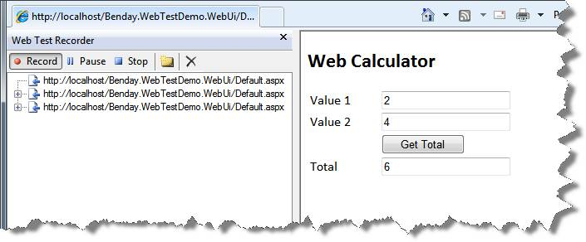
Functional Approach
Notes:
https://www.flickr.com/photos/binaryape/4882162452/in/photolist-8rqmNG-nNSkQU-6kckHp-mB124t-5vgq6Y-7r2e3h-8cD5nx-4WHXzW-pd6c6M-kcRd7x-7yahjU-rgf3RD-a4JZq-bH4FWc-8hDCW3-7HSuP2-byFRMV-iDBVd1-qS9iii-jwPswV-rByRS7-x8YA2b-qmoRhB-2sWNXX-nrEDTy-4CHj67-8Cjveb-bC2UPc-GW2Va-ibCEkV-aswFR8-7KtbgT-tReNJt-4r5sPk-4CHiyy-28i54x-7QTwNd-d7HmTA-uj58iZ-brT6Uv-5sARbG-s8otHi-dXkp3b-bB13yf-78SpzZ-i9sMcF-gmv5Vj-4BrcEY-5LfUcS-9QALSm

Slide 15
Key Point #3
Which version of
Visual Studio?

Slide 16
Functional Approach
DB
<XML\>
Notes:
https://www.flickr.com/photos/binaryape/4882162452/in/photolist-8rqmNG-nNSkQU-6kckHp-mB124t-5vgq6Y-7r2e3h-8cD5nx-4WHXzW-pd6c6M-kcRd7x-7yahjU-rgf3RD-a4JZq-bH4FWc-8hDCW3-7HSuP2-byFRMV-iDBVd1-qS9iii-jwPswV-rByRS7-x8YA2b-qmoRhB-2sWNXX-nrEDTy-4CHj67-8Cjveb-bC2UPc-GW2Va-ibCEkV-aswFR8-7KtbgT-tReNJt-4r5sPk-4CHiyy-28i54x-7QTwNd-d7HmTA-uj58iZ-brT6Uv-5sARbG-s8otHi-dXkp3b-bB13yf-78SpzZ-i9sMcF-gmv5Vj-4BrcEY-5LfUcS-9QALSm

Slide 17
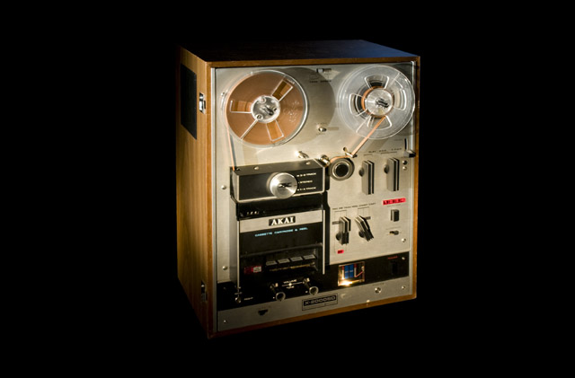
Notes:
Record/Playback
Relies on REST and URI

Slide 18
Key Point #4
Don’t Assume the Application Works the Way it “Should”

Slide 19
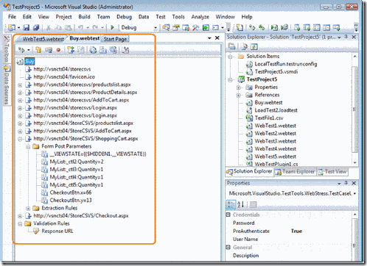

Slide 20


Slide 21

Building A Test Lab
Visual
Studio
Test
Agent
Test
Controller
Test
Agent
SQL
Express
Test
Agent

Slide 22
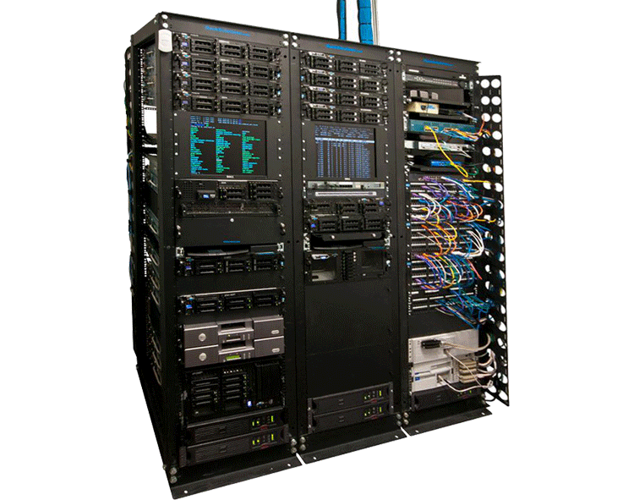

Slide 23
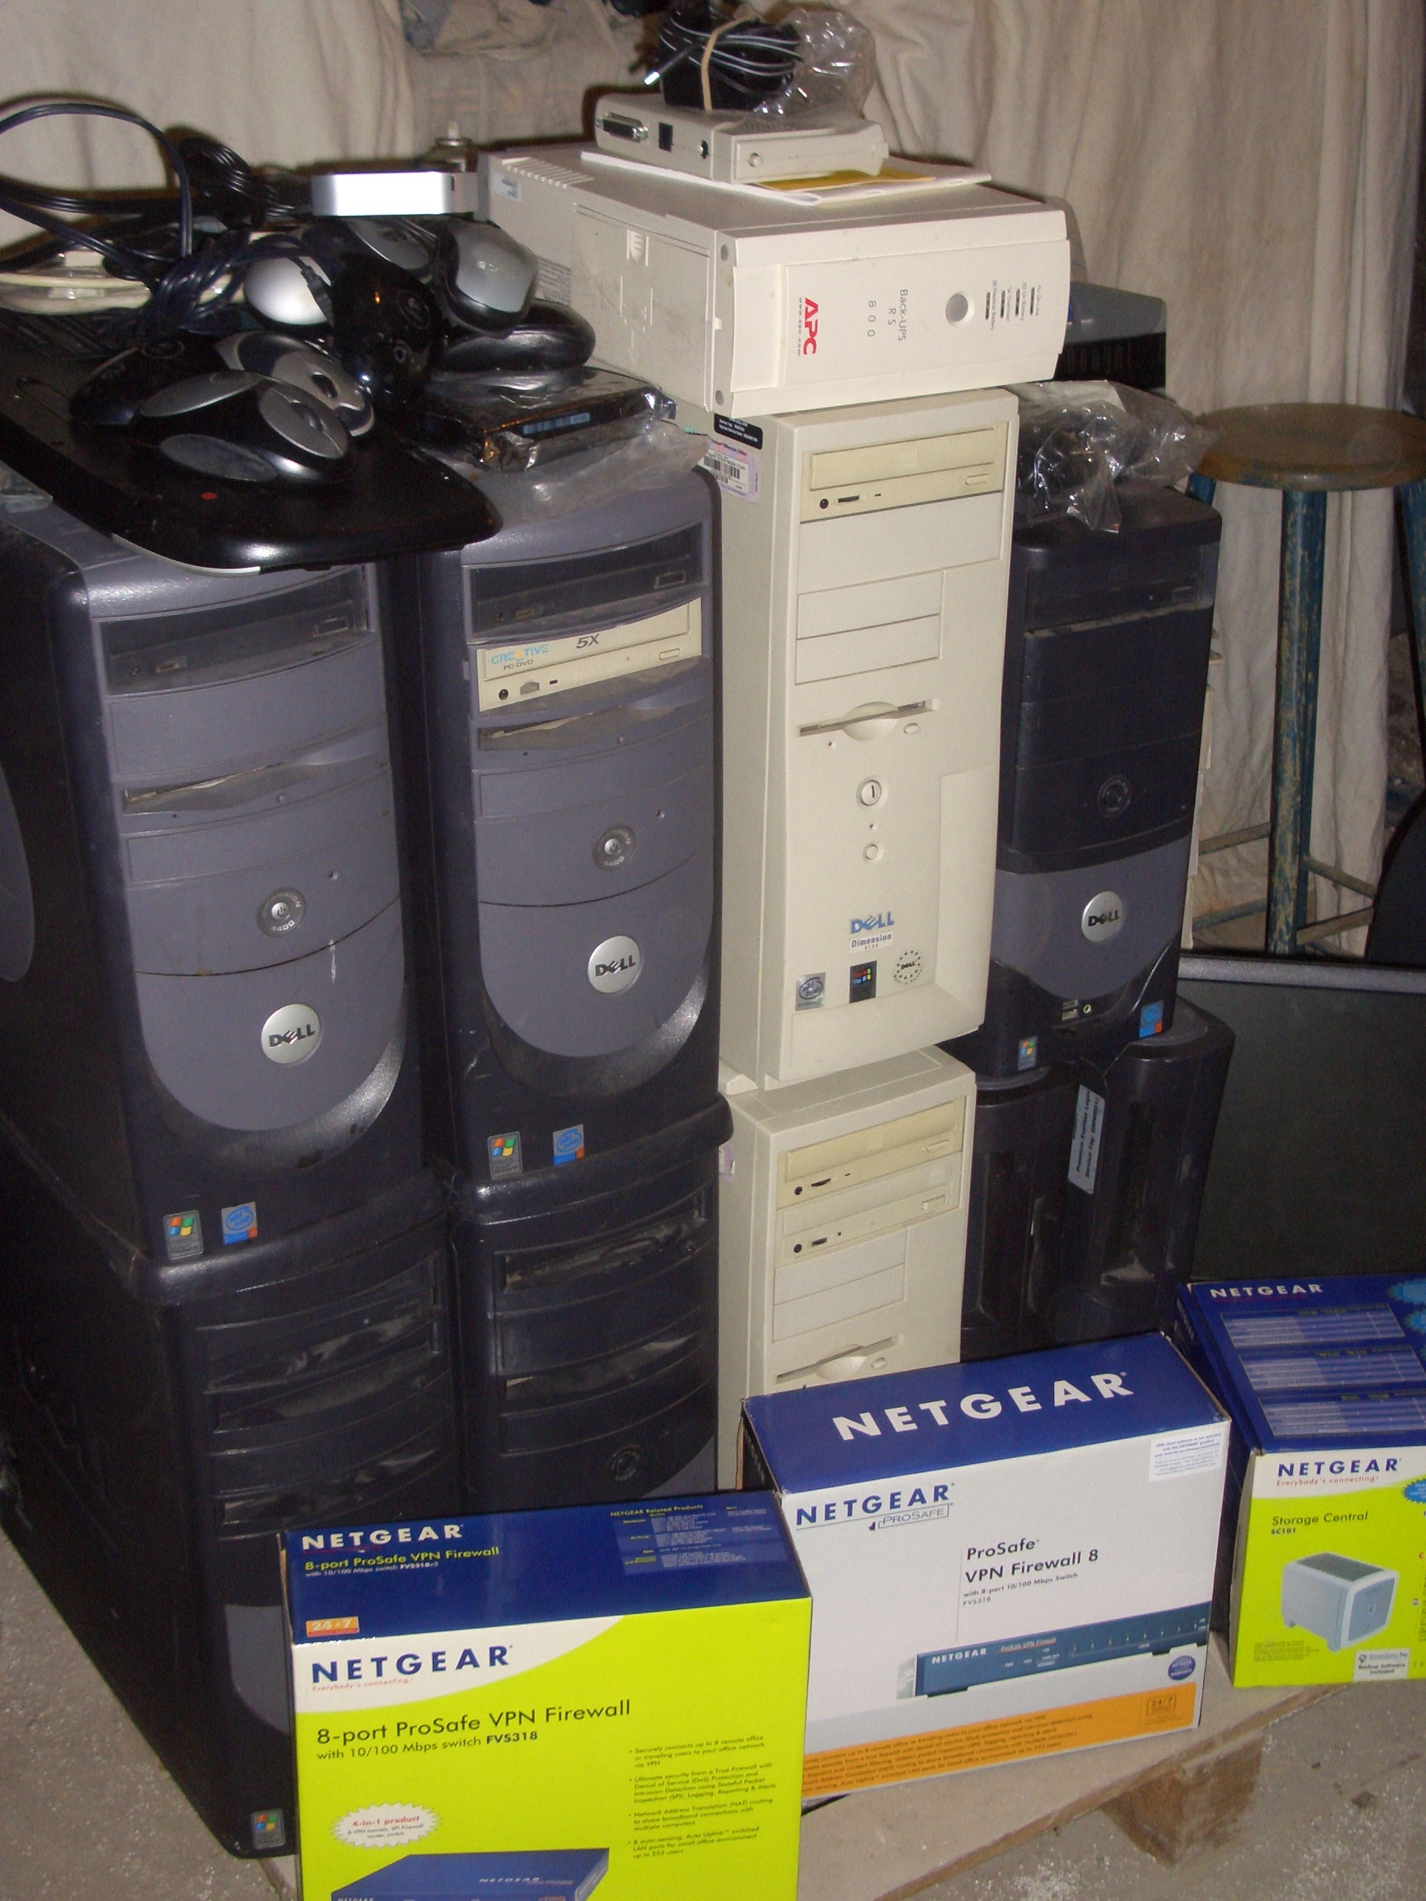

Slide 24
Key Point #5
Verify your hardware expectations – ALL OF THEM!

Slide 25
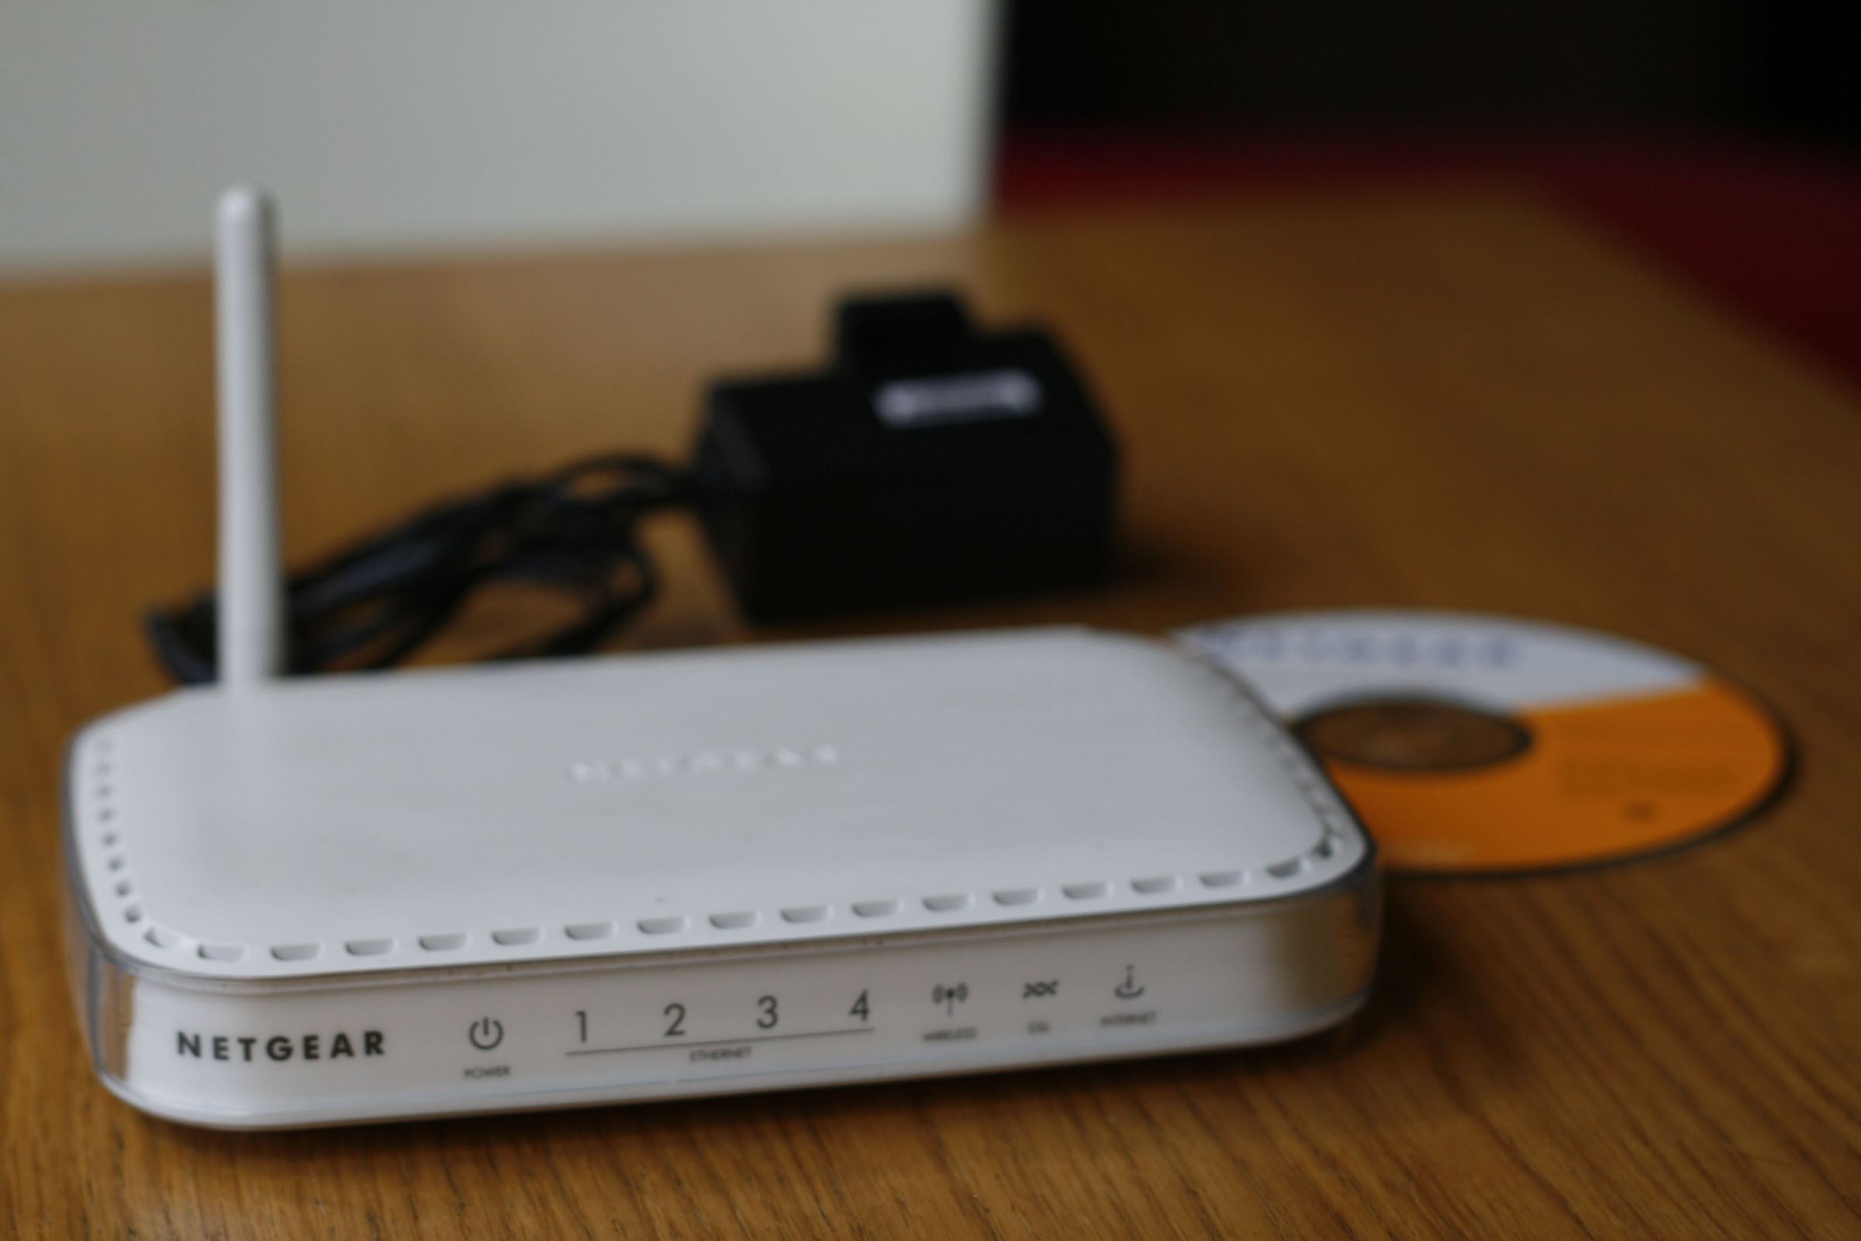

Slide 26
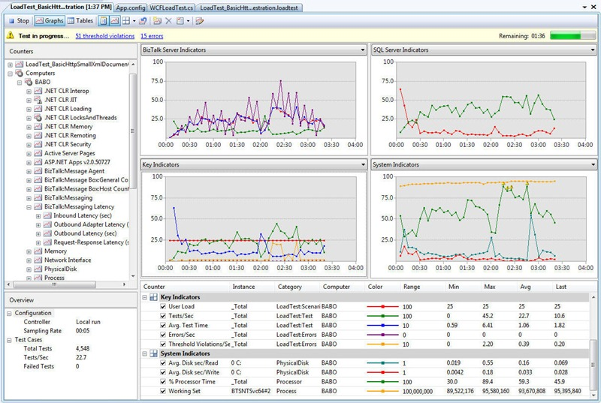

Slide 27
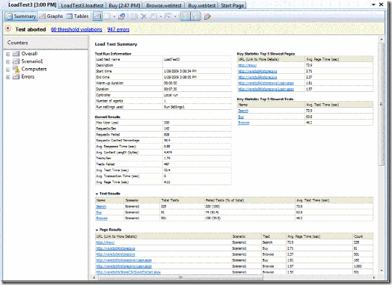

Slide 28
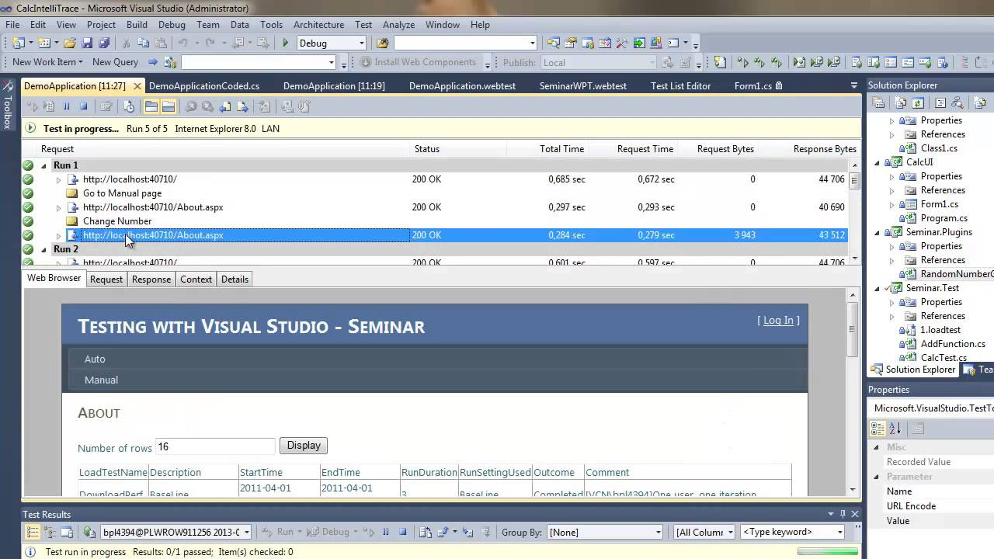

Slide 29
Key Point #6
Make sure you are seeing a FULL PICTURE or your applications performance.

Slide 30

Web Server performance
SQL Server performance

Slide 31
Key Point #7
Remember: Your performance problem my not be in your application.

Slide 32
Some helpful links
Documenation on MSDN - http://bit.ly/1LiYaCN
Pluralsight Course by Benjamin Day
Getting started blog post - http://bit.ly/1hrCSa6

Slide 33

Thank you!
www.JamesCBender.com
github.com/JamesBender
james@jamescbender.com
Twitter: @JamesBender
hallwayconversations.com

